Slide 1

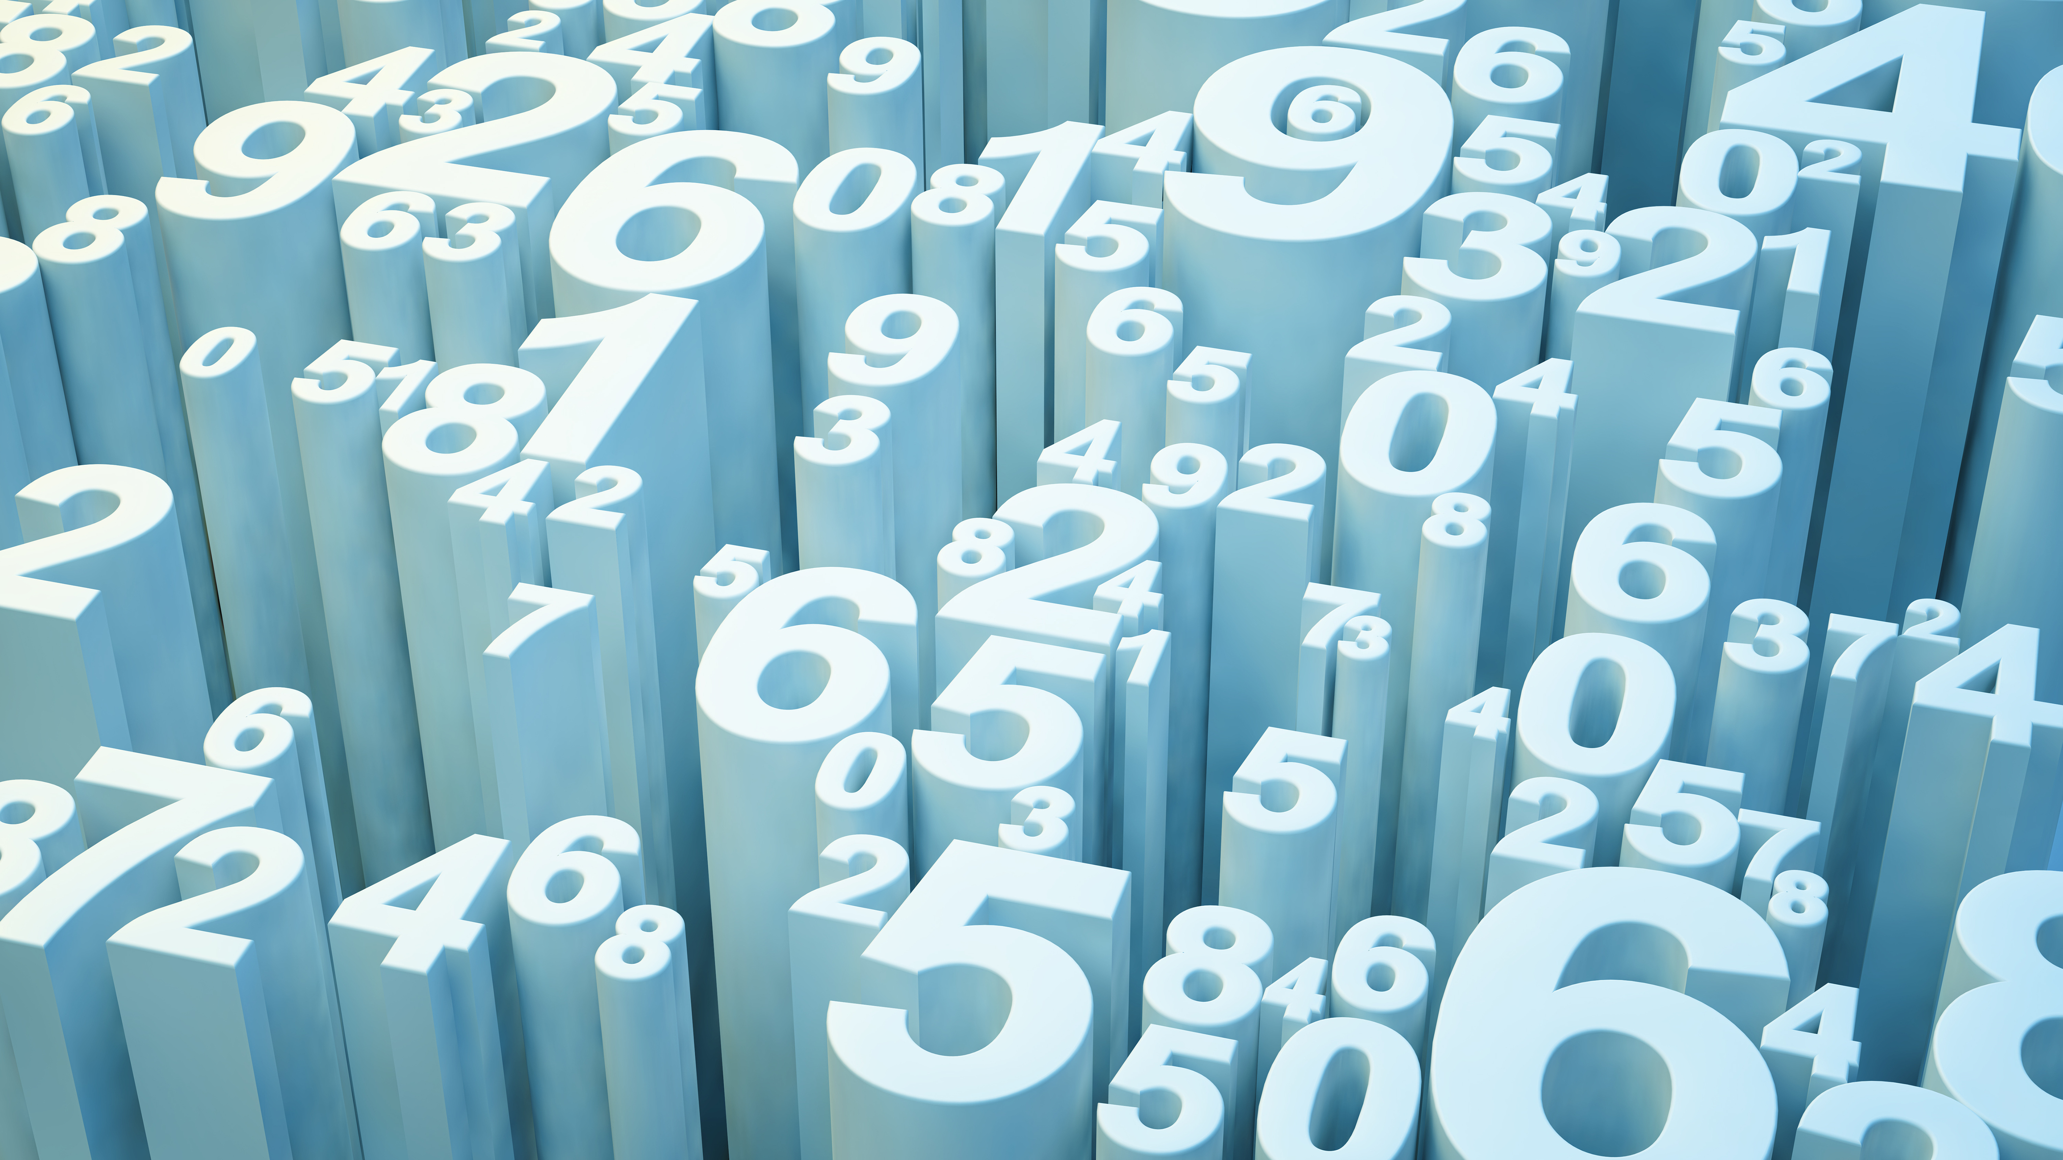
Stock Data Visualization
Project II

Slide 2
INDEX
Topics
Page No.s
Introduction
Downloading Stock Data
Bollinger Bands
Ichimoku Kinko Hyo
An Interesting Observation
Conclusion
3
4
5
8
12
13

Slide 3
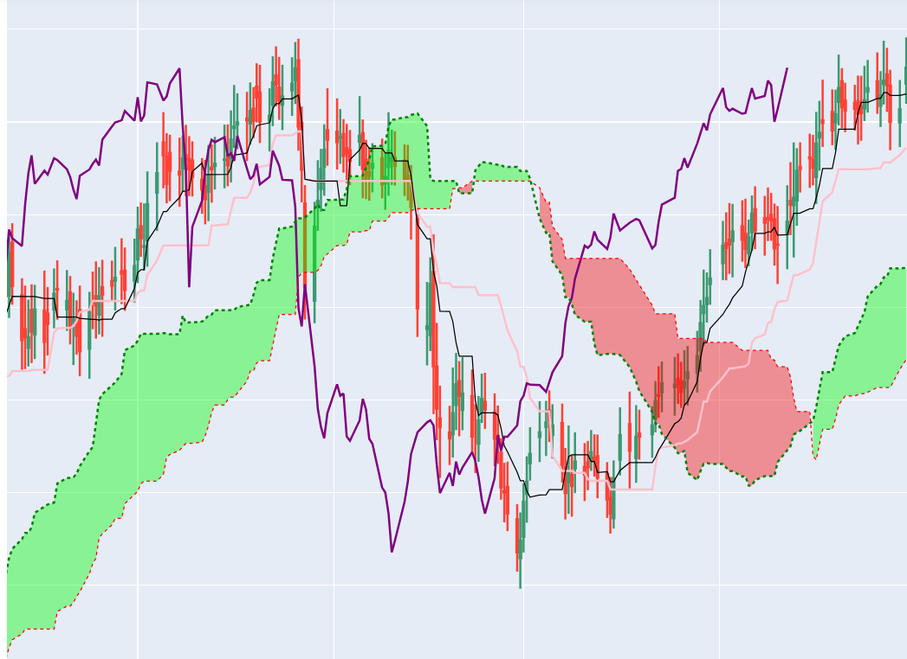
INTRODUCTION
In this project, various market visualization techniques are explored, mainly the Bollinger bands and the Ichimoku Kinko Hyo. These techniques are used to visualize the data of NIFTY and the portfolio made in the previous project.

Slide 4
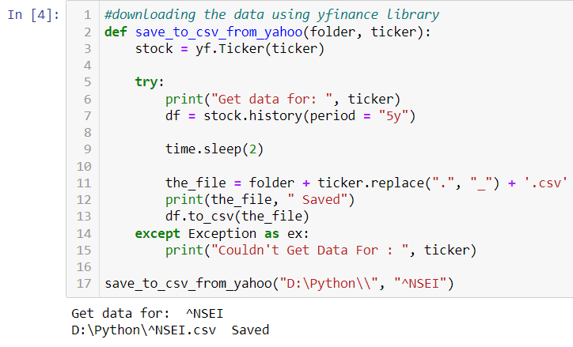
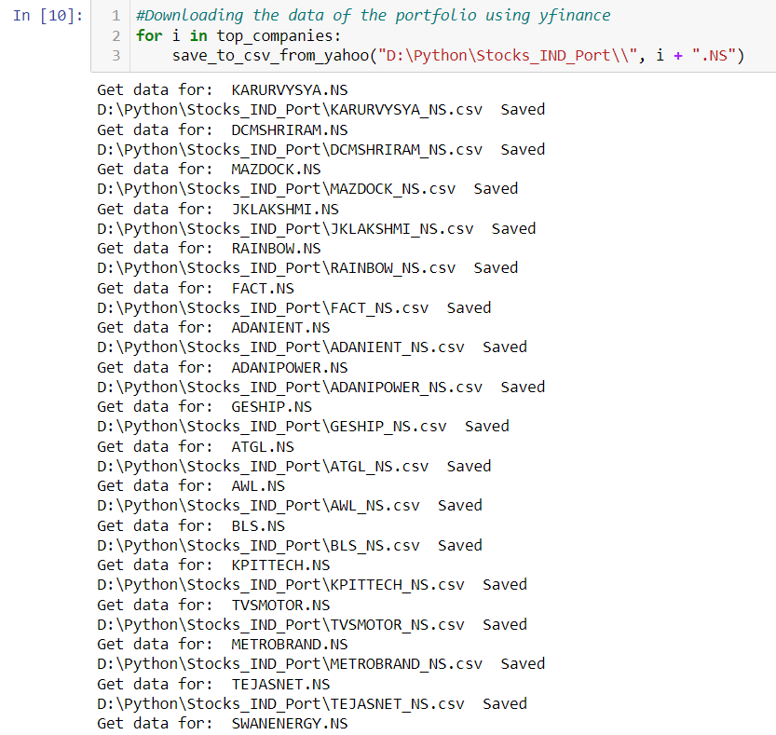
DOWNLOADING STOCK DATA
For this project, yfinance is used to download all stock data. Yahoo Finance has an attribute Ticker, which downloads the High, Low, Open, Close, Volume, Dividends and Stock_Split data of a stock for a specific time from present time in the past. This gives us a lot of information about the stock itself and helps us make statistical analysis using the data.

Slide 5
BOLLINGER BANDS
Bollinger Bands are envelopes made by a moving average for a specific time period (mostly 20 days) and envelopes of a specific standard deviation (mostly 2 or 1.96 in the case of this project) above and below the moving average. Named on their creator John Bollinger, these bands adjust themselves based on the current volatility swings of the underlying price of the market because of them being based on standard deviations.
Moving Averages give an idea about the where the expected price of a stock is headed to, if the stock price is above the moving average, it signifies the market being bullish, otherwise bearish. The bands give us the an idea about the most probable maximum profit or loss that can be endured in the market at a moment.
For making the Bollinger Bands, we add three more columns to our dataframe containing stock price data.
Middle_band : The data of moving average for 20 days.
Upper_band : The data of moving average + 1.96 times the standard deviation in closing price of the data for 20 days.
Lower_band : The data of moving average - 1.96 times the standard deviation in closing price of the data for 20 days.

Slide 6
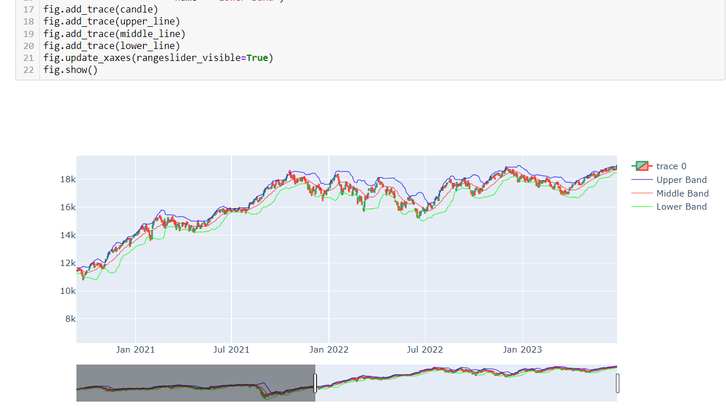
Bollinger Bands Diagram of NIFTY

Slide 7
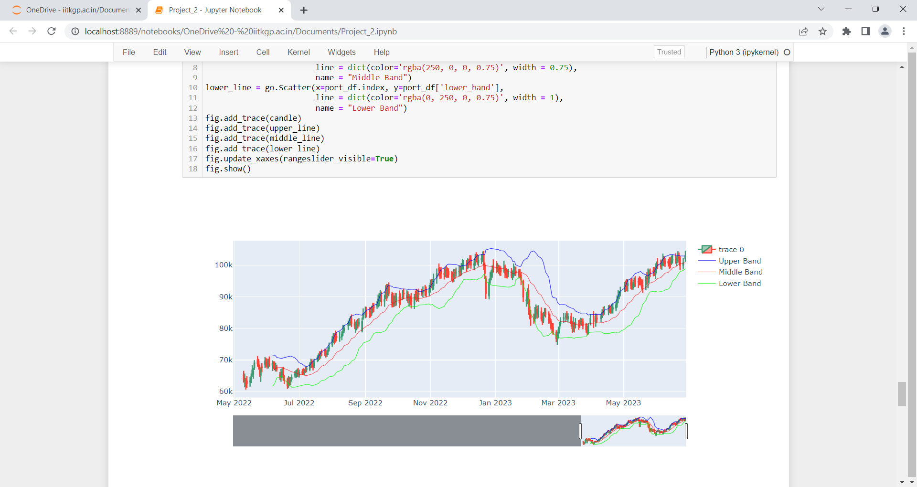
Bollinger Bands Diagram of the Portfolio of Project_1
This diagram does not contain data before a certain period of time because few stocks in the portfolio were new and they had not been in market for long, due to which their historical data was limited.

Slide 8
ICHIMOKU KINKO HYO
This is a sophisticated system of stock market visualization, perfected by Japanese journalist, working for a news organization specializing in stock market news, Goichi Hosoda. He used this method in secret for years and in 1969 wrote 7 volumes of books on his methods and his philosophy of the market, under the pen name Ichimoku Sanjin. Ichimoku Kinko Hyo is not just a signalling method to buy or sell stocks when certain patterns appear on the bands, it tells us about the market in general and the momentum and equilibrium of the market.
Ichimoku in general has 5 bands :
Tenkan – sen or the conversion line : This line shows the average of the highest and lowest price of a stock in the past 9 periods.
Kijun – sen or the base line : This line shows the average of the highest and the lowest price of a stock in the past 26 periods.
Senko span A : This data shows the average between Tenkan - sen and Kijun – sen moved forward by 26 periods.
Senko span B : This line shows the average of the highest and the lowest price od the stock in the past 52 periods.
Chiko span : This line shows the Closing price of a stock 26 periods in the past, i.e. the data is actually made by moving the Closing price data of a particular period, 26 periods back.

Slide 9
Numbers such as 9, 26, 52 are used as periods in this Project, but many other such periods can be used as periods. Numbers such as 17, 33, 42, 51, 65, 76 , etc can also be used as periods depending on market conditions. These set of numbers are called Kihon – suchi, these numbers are the number of days a trend lasts as found historically.
Senko span A and Senko span B are similar in a way that they both have effects of stock prices 52 periods prior to them. The region between them is known as the Kumo cloud (not originally named by Goichi Hosoda). This region was called resistance region by the original creator of this system. Whenever the stock price moves in the Kumo cloud, it is advised to not trade as the stocks inside the cloud is not definite to follow any particular pattern and might switch trends. This is why it was called the resistance region, where traders should resist themselves from opening or closing trades.
The Tenkan – sen is the short term trend of the market and the Kijun – sen is the medium term trend of the market. The Chiko span is mostly used as a confirmer of the predictions made using the other 4 bands.
Ichimoku Kinko Hyo, again, is much more than just a prediction chart. It has a whole philosophy behind it. The main theories behind the stock market as stated by Goichi Hosoda were Time Theory, Wave Theory and Price Observation Theory.

Slide 10
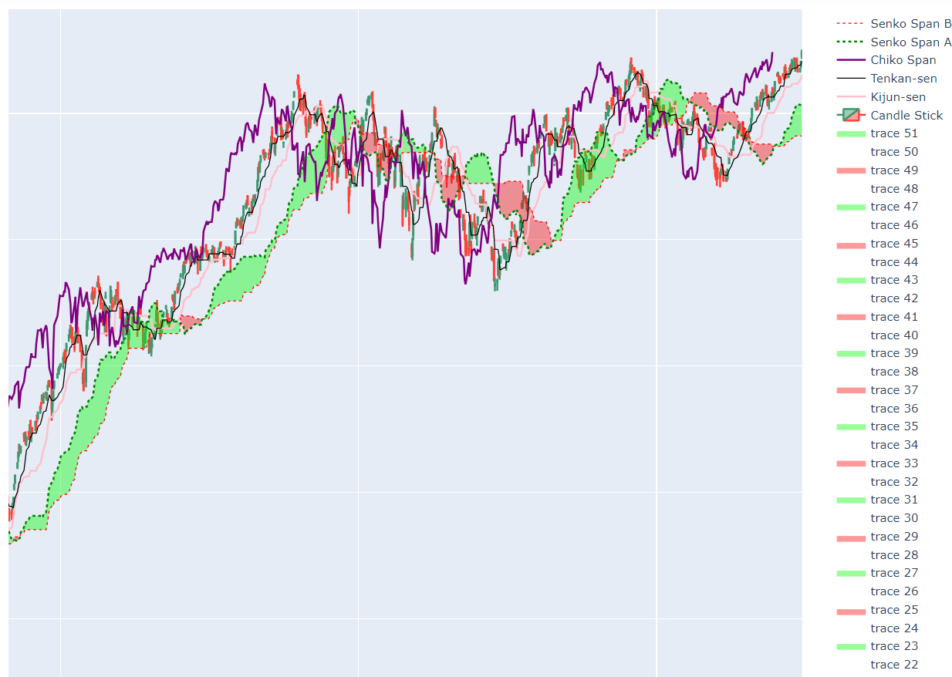
Ichimoku Kinko Hyo of NIFTY

Slide 11
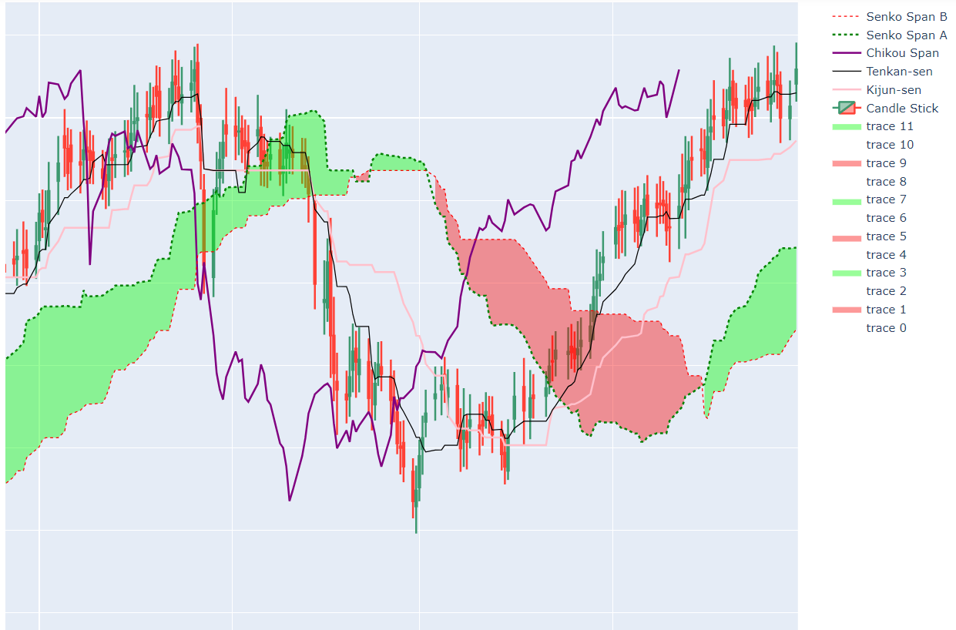
Ichimoku Kinko Hyo of the Portfolio of Project_1

Slide 12
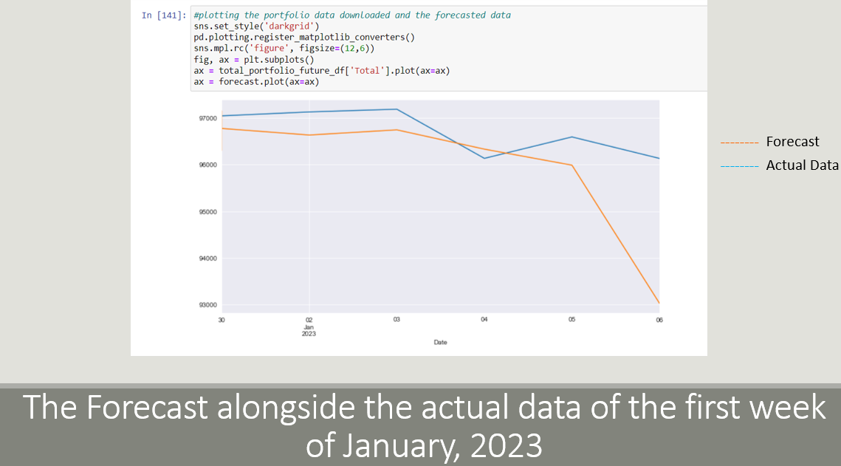
AN INTERSTING OBSERVATION
It is observed that after January, 2023, the value of the portfolio takes a dip. It rises after a few months, but this dip deepens a lot during the first couple of months of 2023. This dip at the exact time of the year was predicted by the Auto Regression model of Project_1
This shows the Auto Regression Model used in the Project_1 was pretty good for short term predictions.

Slide 13
CONCLUSION
This project gives us an idea of how technical analysis of stock market is done. Every visualization technique has its own theory and philosophy behind them, some are simple like moving averages, some quite sophisticated like the Ichimoku technique.
Sources:
For most queries and doubts : https://www.google.com/
For information on Ichimoku Kinko Hyo : https://www.youtube.com/@KeiForex

